Slide 1

EDA on Movie Data
Sri Harsha

Slide 2
Questions that matter
In last few years, the film industry has become more popular than ever. In 2018, movies made total income around $ 41.7 billion throughout the world. But what movies make the most money at the box office?
How much does a director matter?
Do ratings and metascore mean anything? Do certain actors and/or genre amount to good revenues for producers?

Slide 3
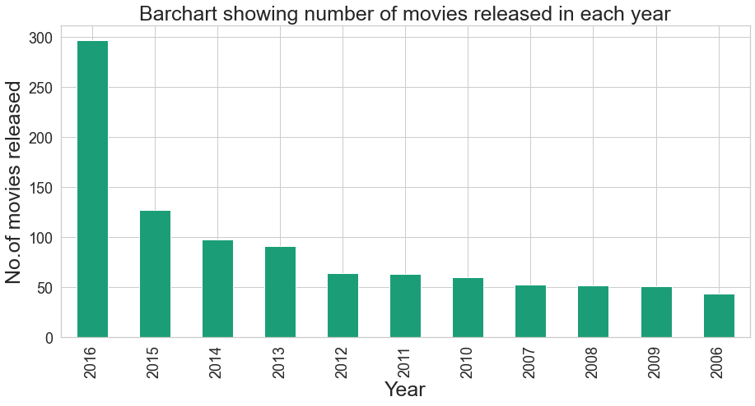
Number of movies released in each year from 2006 to 2016

Slide 4
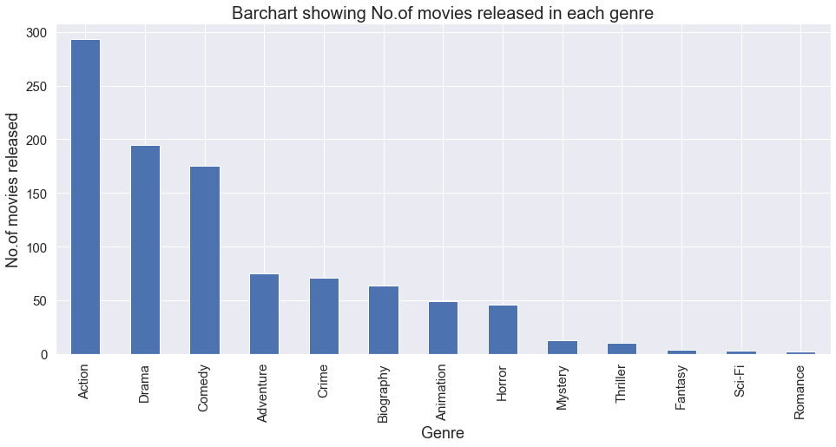
Number of movies released in each Genre from 2006 to 2016

Slide 5
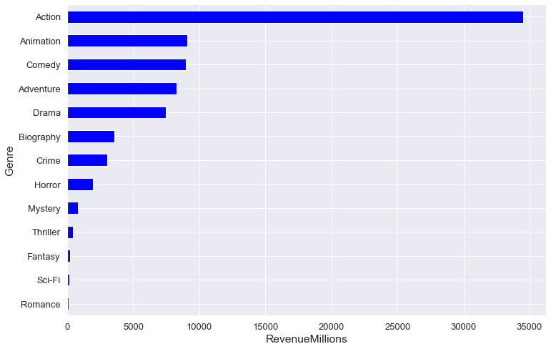
Which genre has made the revenue from highest to lowest

Slide 6
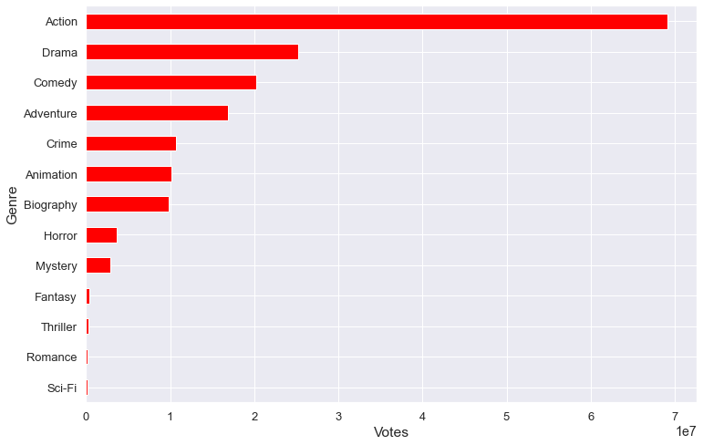
Which genre has got the Votes from highest to lowest

Slide 7
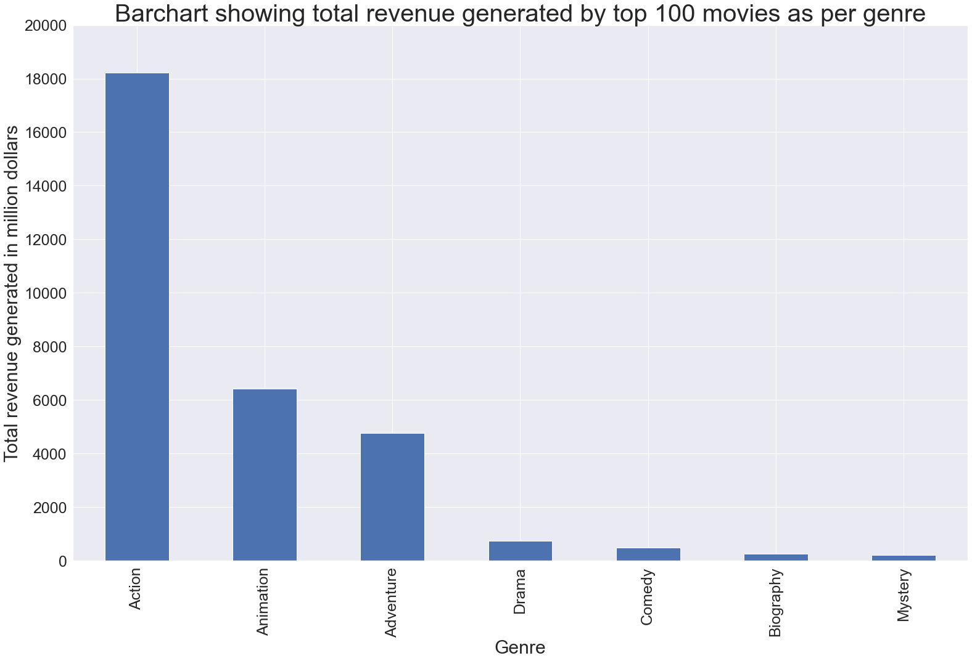
Revenue generated by top 100 movies as per the genre
As per the data we can see that movies from Action genre has generated an revenue of 18225.2 millions followed by Animation genre with revenue of 6429.58 millions.
From this data we can depict that Action genre has more chances of generating huge revenue in future years compared to other genre

Slide 8
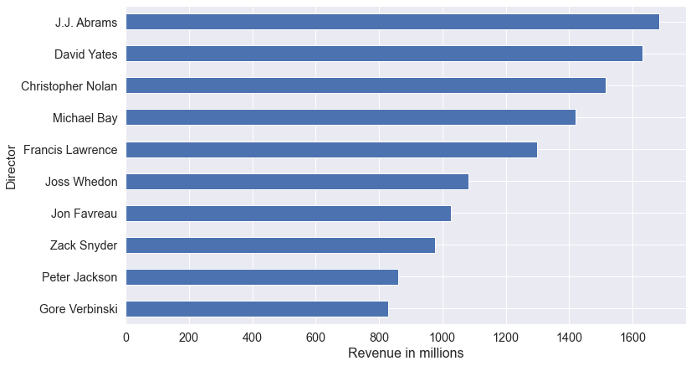
Top Directors who generated most Revenue
As per the data J.J. Abrams has generated an highest revenue of 1683.45 millions who has most of his direction into Action genre.

Slide 9
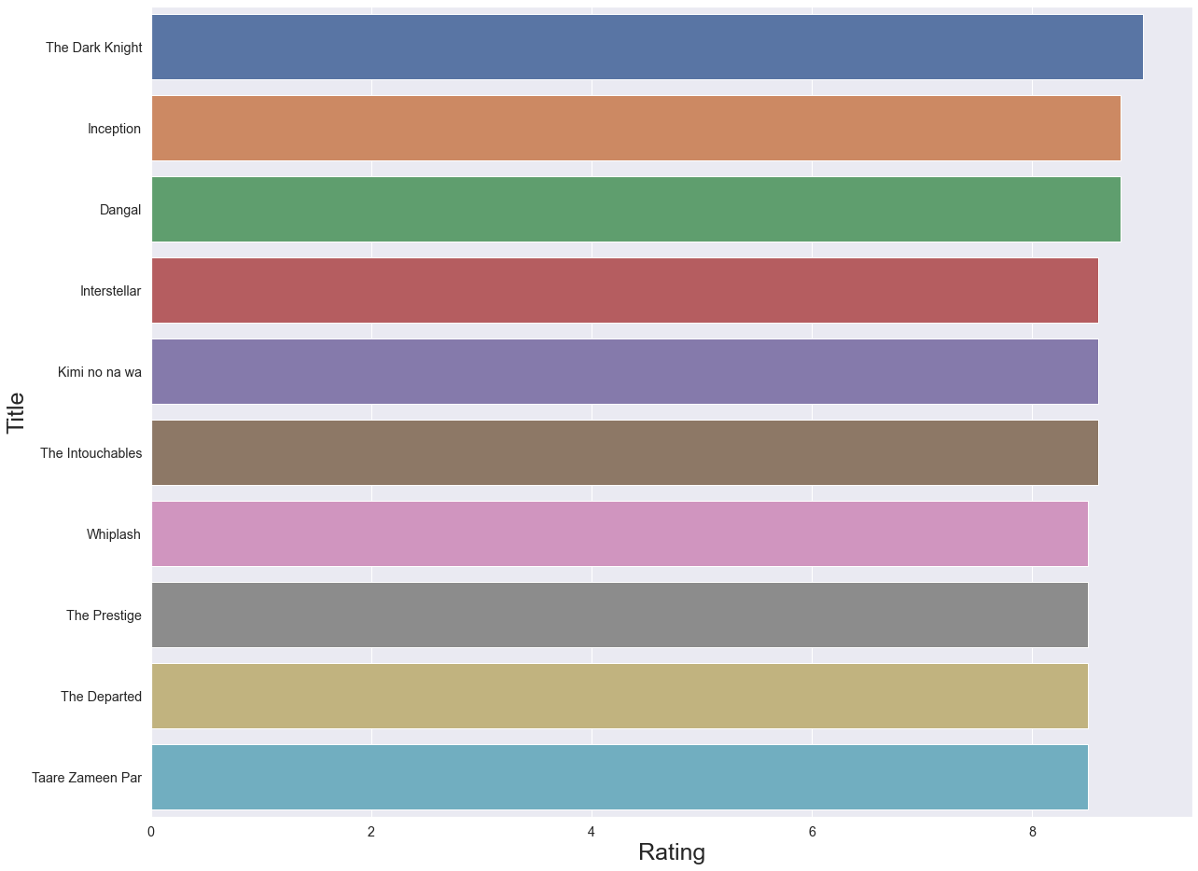
Top 10 movies as per the audience ratings
The Dark Knight is the movie which has highest Rating of 9/10 directed by Christopher Nolan released in 2008

Slide 10
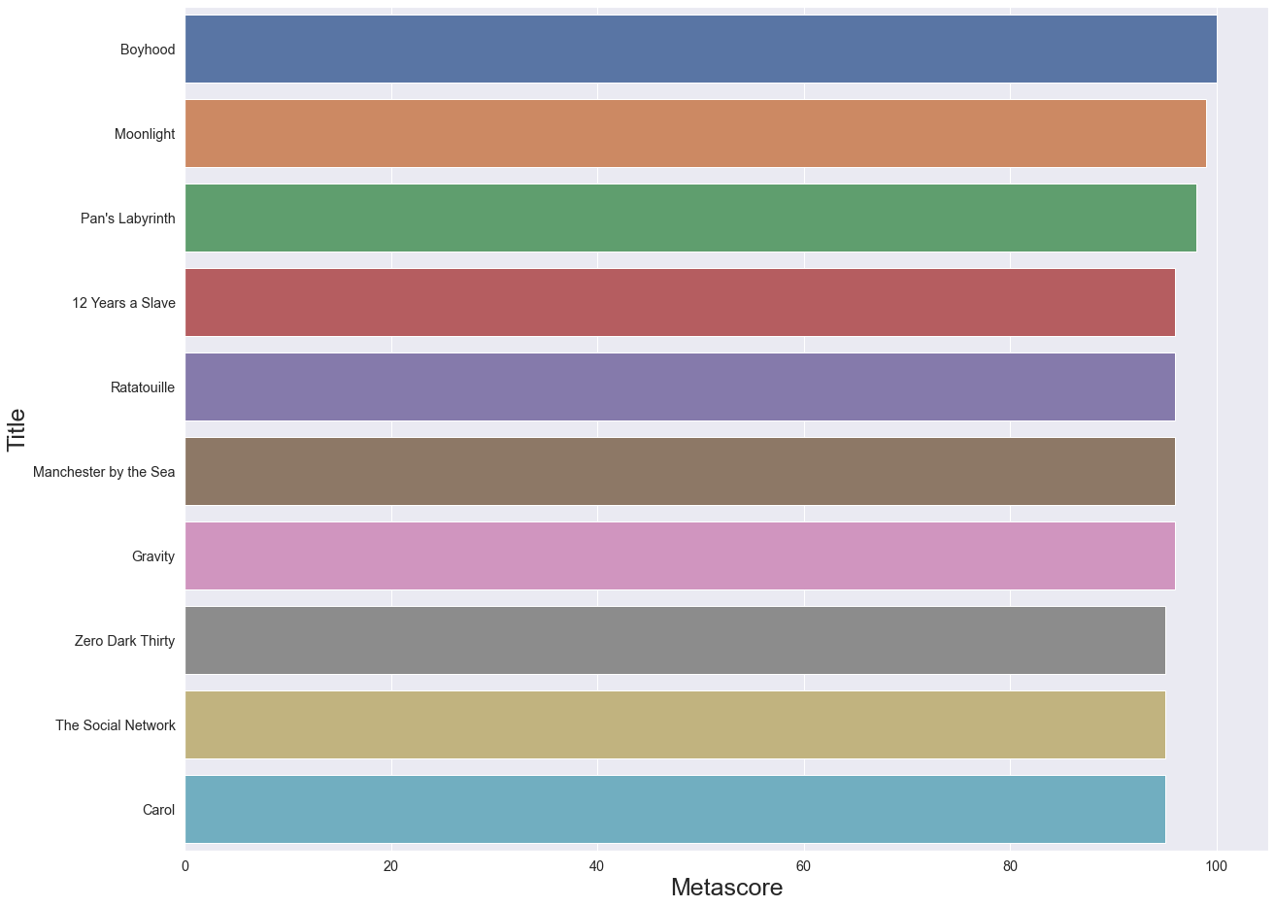
Top 10 movies as per the critic ratings
Boyhood is the movie which has highest Rating of 100/100 directed by Richard Linklater released in 2014

Slide 11
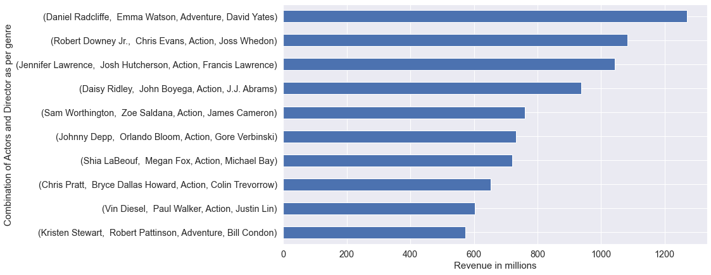
Top 10 actors and Director combinations as per genre that generated highest revenue

Slide 12
Few Insights from the movies data
Director J.J. Abrams has made the highest revenue in Action Genre of 1.56 billion followed by Joss Whedon with an revenue of 1.08 billion.
Director David Yates has made the highest revenue in Adventure Genre of over 1.2 billion with main actors as Daniel Radcliffe and Emma Watson.
Director Pete Docter has made the highest revenue of 649.43 million in animation genre.
There are 55 Action Genre movies in top 100 movies which made the revenue of 18.225 billion and with average audience rating of 7.2 and Metascore of 65
There are 22 Animation Genre movies in top 100 movies which made the revenue of 6.429 billion and with average audience rating of 7.6 and Metascore of 75
Action genre has generated the highest revenue of 34513.48 millions followed by Animation genre with revenue of 9083.46 millions.

Slide 13
Thank you

